Slide 1

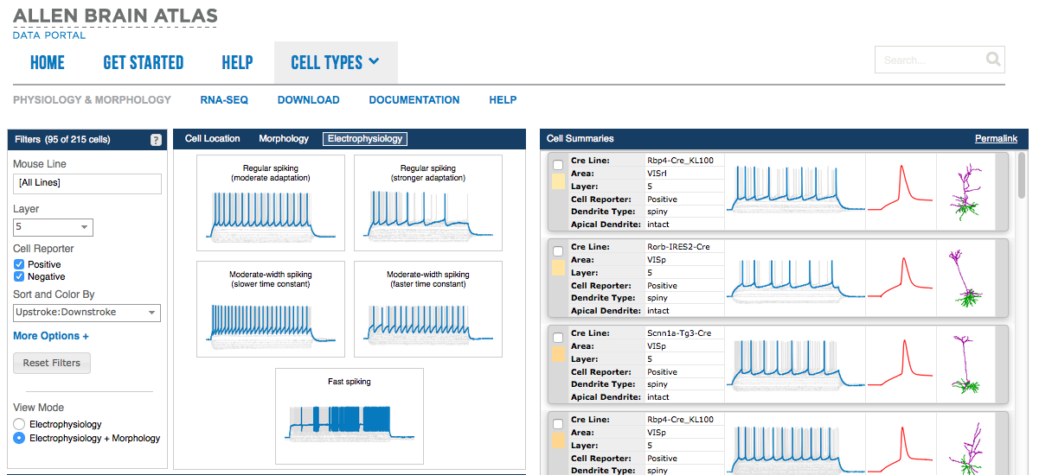
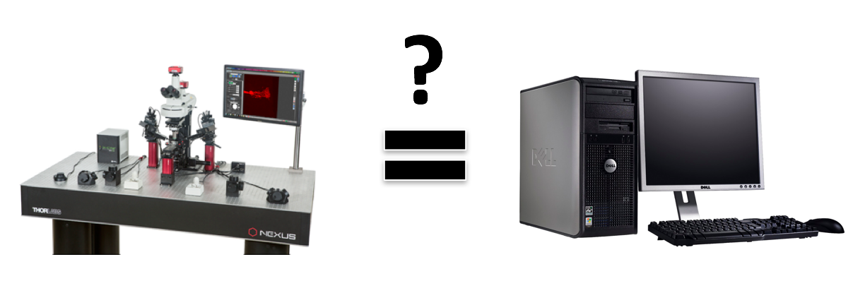
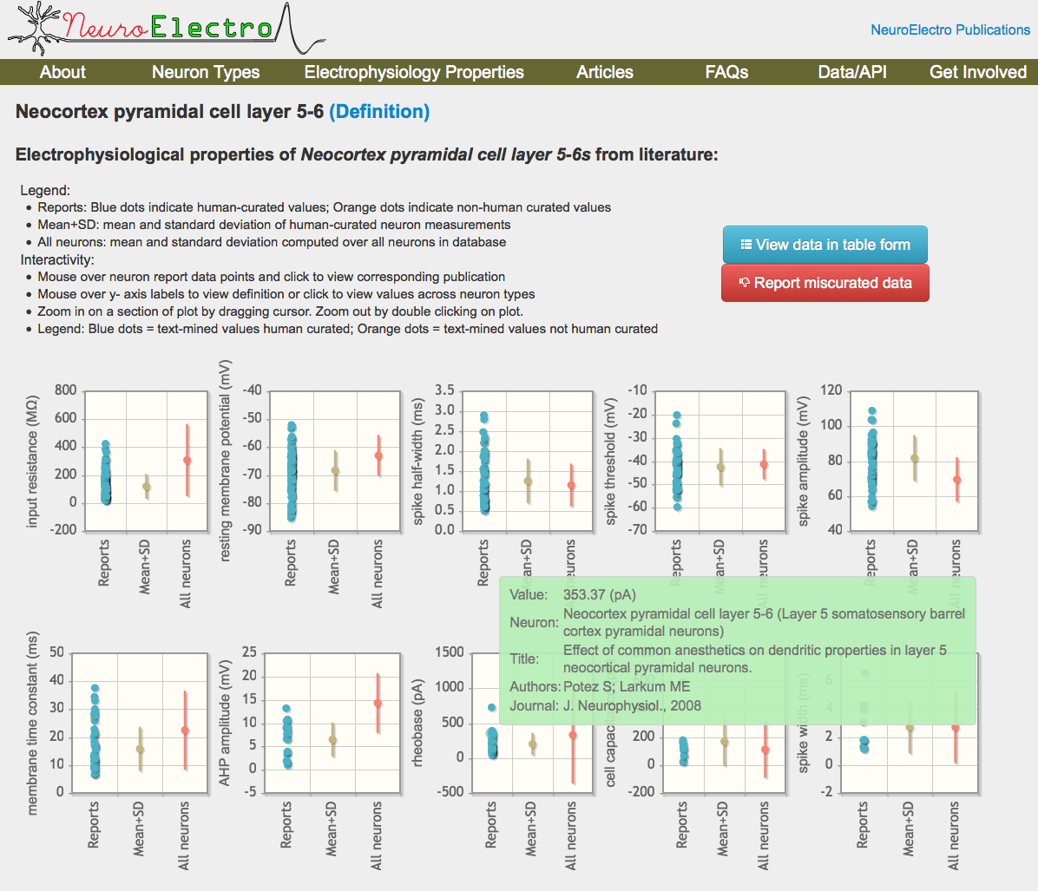
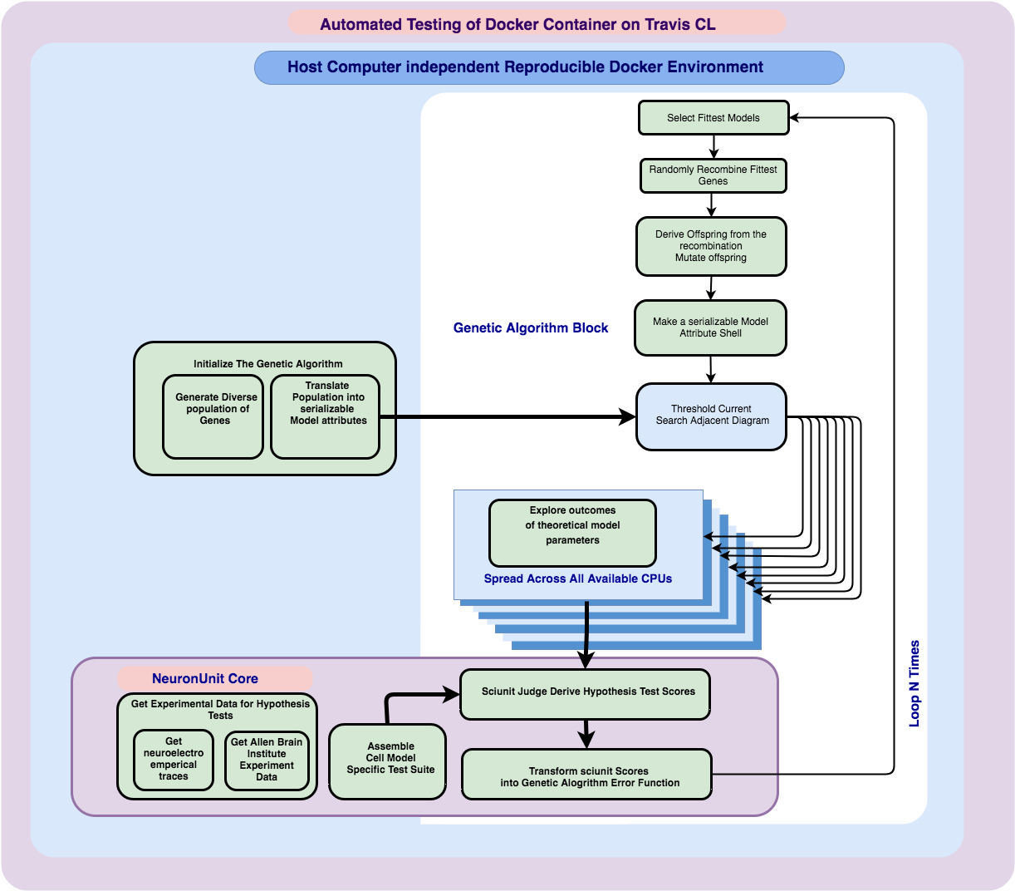
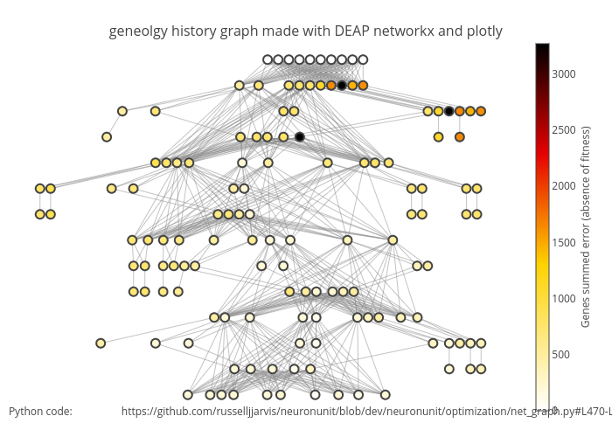
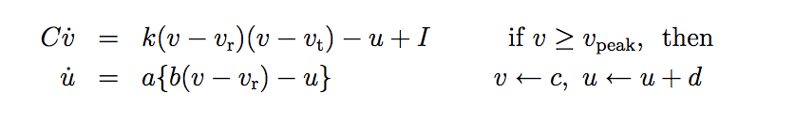
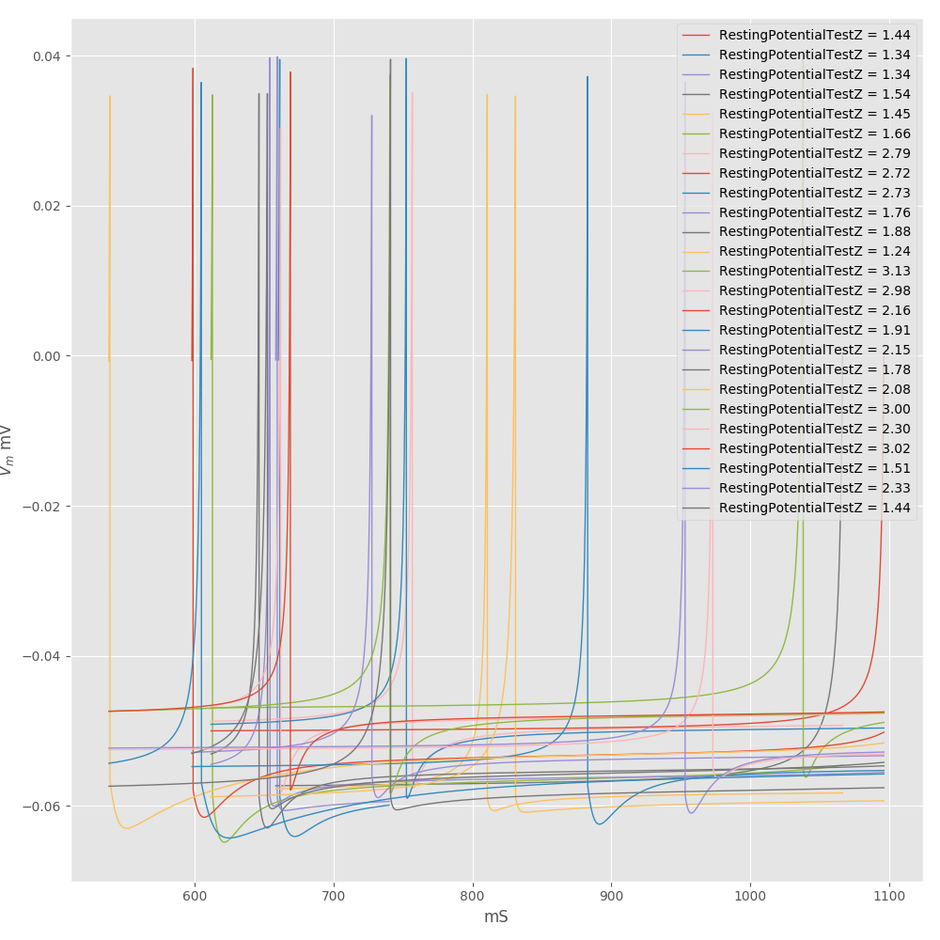
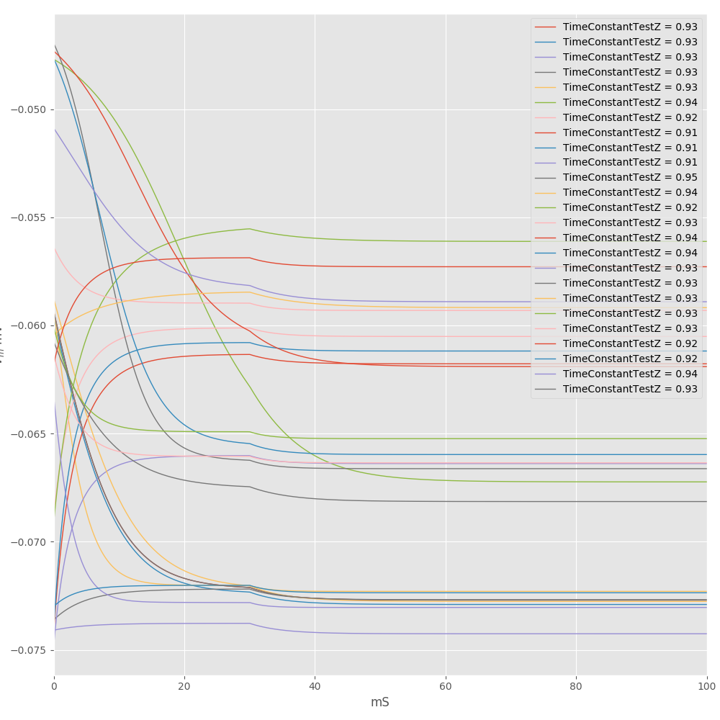
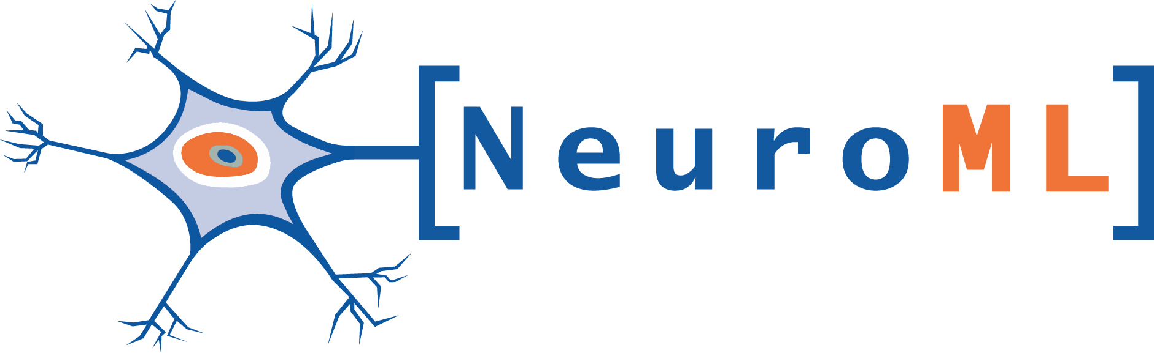

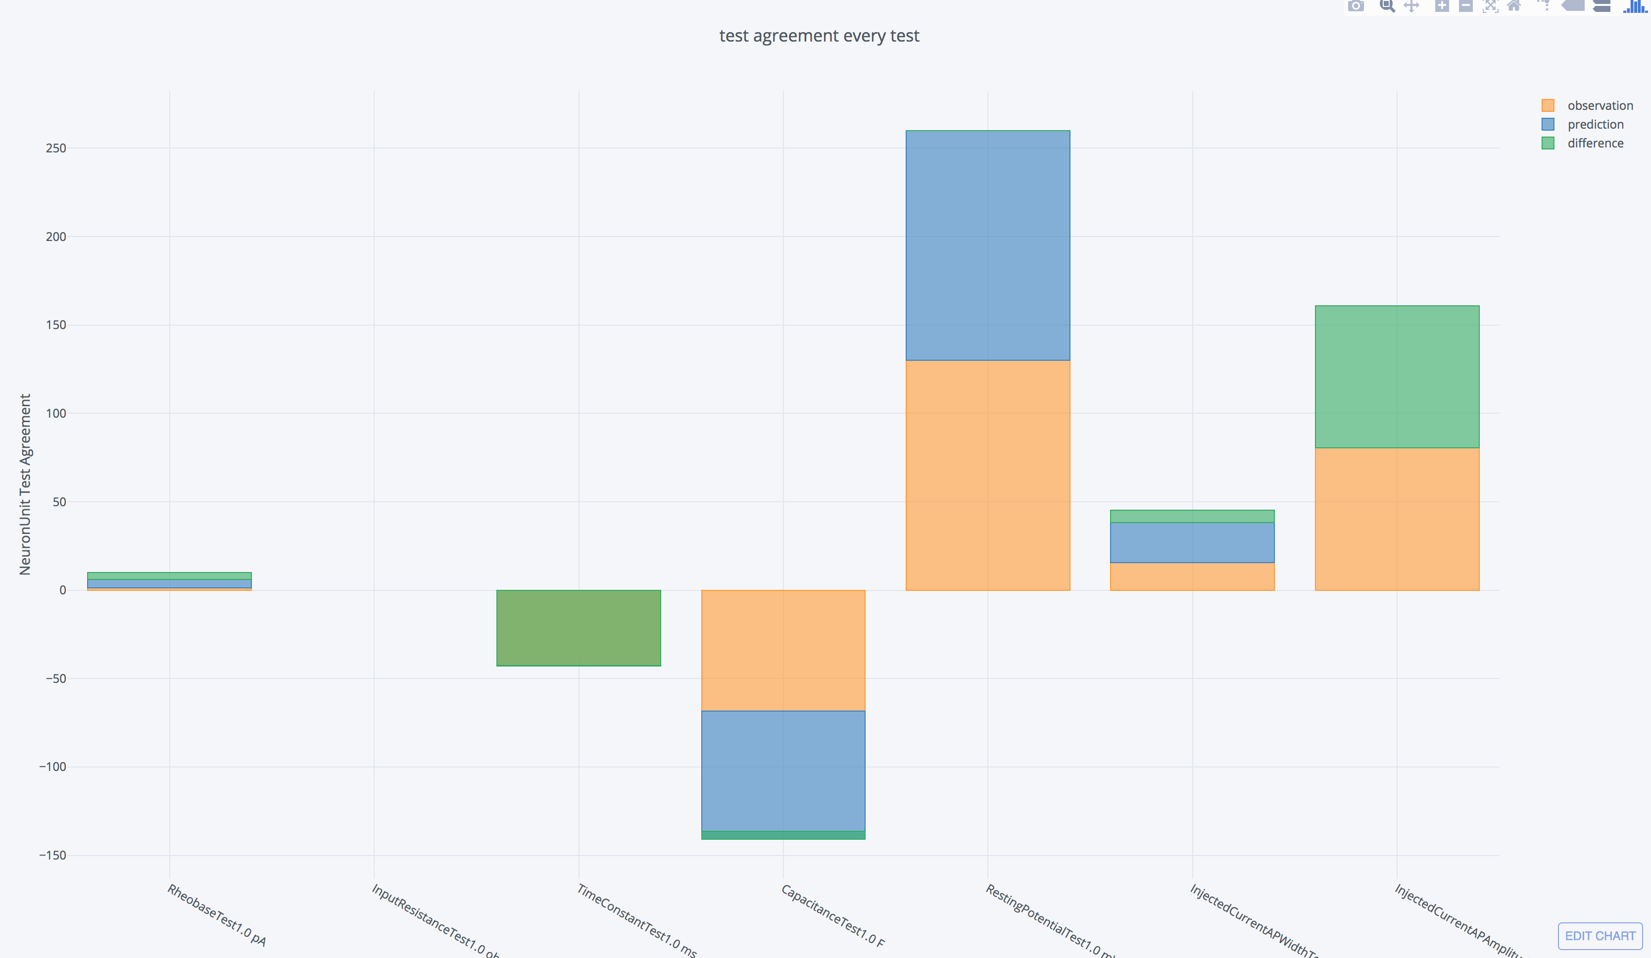


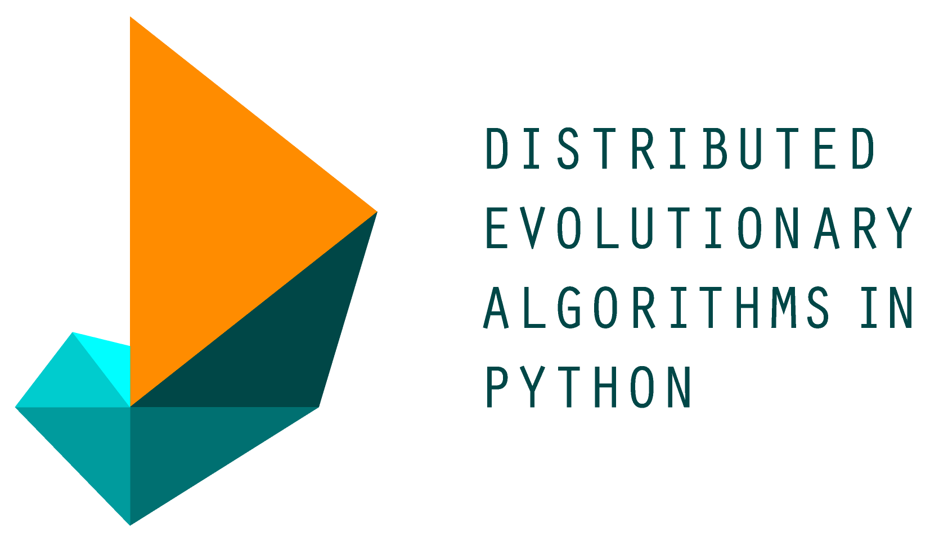
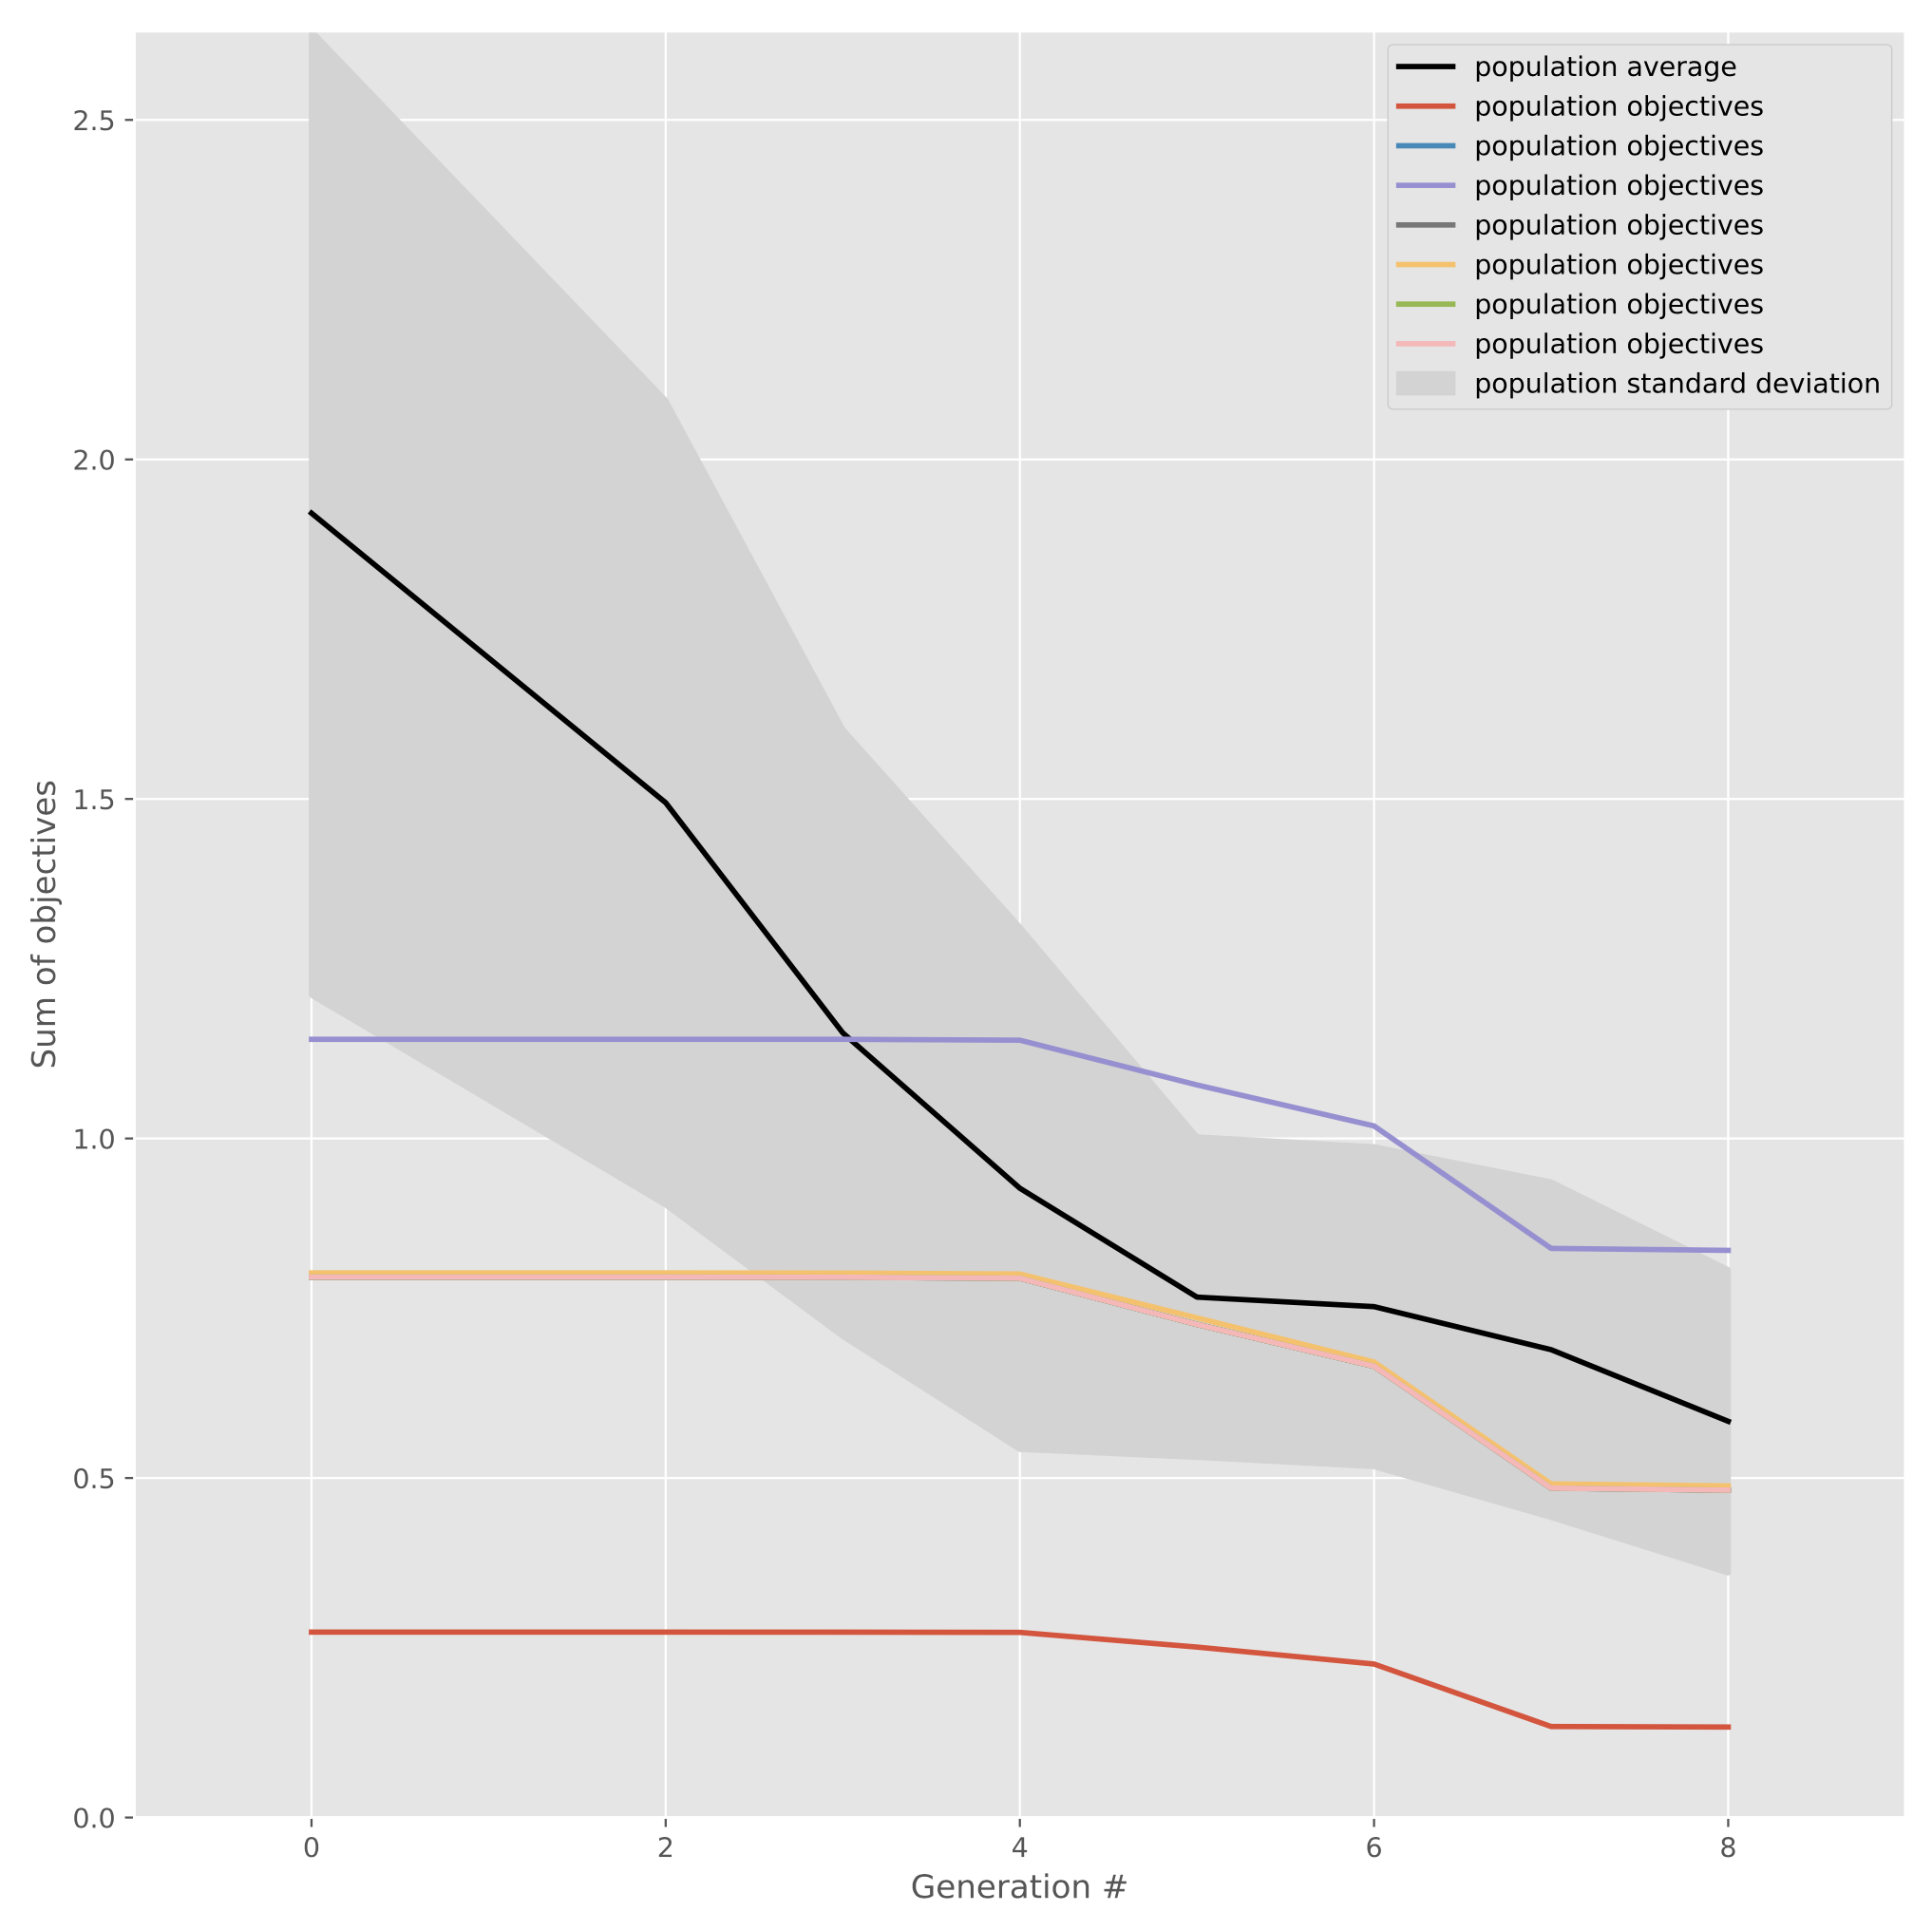

4 spikes
PARALLEL MODEL OPTIMIZATION AGAINST EXPERIMENTAL DATA WITH NEURONUNIT
0 spikes
50pA
0 spikes
12 spikes
Sub firing
133.33pA
CPU 0
144.44pA
0 spikes
66.66pA
Supra-firing
CPU 1
0 spikes
83.33pA
CPU 2
0 spikes
116.66pA
Russell Jarrod Jarvis, Richard C. Gerkin, Sharon M. Crook
0 spikes
Sub-firing
1 spike
CPU 3
Supra-firing
CPU 4
Laboratory for Informatics and Computation in Open Neuroscience
Arizona State University
166.66pA
150pA
1 spike
CPU 5
4 spikes
2 spikes
CPU 6
http://iconlab.asu.edu
MODEL VALIDATION
RESULTS
SOFTWARE DESIGN
Scientific insight is well-served by the discovery and optimization of abstract neuron models that can reproduce experimental findings. We have developed a model validation framework, NeuronUnit, that employs suites of “tests” that evaluate model results against experimental data, a formalization of the scientific method [1].
Initial acquisitions of paired parameter cross sections in the parameter parameter space hyper volume show that the error surface has several minima, thus warranting a genetic algorithm approach.
For a single model class and biological neuron type, we obtained an error surface via a Non-Dominated Sort Genetic Algorithm (NSGA), corresponding to plausible subsets of candidate parameter values that respect intrinsic biological diversity.
http://neuronunit.scidash.org
We demonstrate the efficiency of our approach for a variety of model types, testing against experimental data from both NeuroElectro.org [4] and the Allen Institute Cell Types database [5].
MODEL FITTING
Using this framework, model parameters can be varied in order to fit experimental data, where NeuronUnit tests provide an evaluation of fitness. To scale such tests to a wide variety of biological neuron types and a range of model classes, computationally efficient techniques for test-driven model optimization are needed. Here we use parallel genetic algorithms to efficiently sample a large model parameter space in the context of NeuronUnit testing of models.
Optimization relies on the Distributed Evolutionary Algorithm in Python (DEAP) library.
EXAMPLES
*
We demonstrate this approach with validation against experimental data for one type of reduced neuron model -- the Izhikevich model [2]. This model is capable of reproducing a large number of cell behaviors by varying model parameters.
4 spikes
0 spikes
50pA
0 spikes
12 spikes
Sub firing
133.33pA
CPU 0
144.44pA
*
0 spikes
66.66pA
Supra-firing
CPU 1
0 spikes
83.33pA
CPU 2
0 spikes
116.66pA
CPU 3
0 spikes
Sub-firing
1 spike
CPU 4
Supra-firing
1 spike
CPU 5
166.66pA
4 spikes
150pA
2 spikes
CPU 6
Many different Technologies were used in this work The common factor underlying each Technology is that they result in greater Reproducibility via facilitating Modularity, Standization, Openness and Data Sharing
REFERENCES
Sarma GP, Jacobs TW, Watts MD, Ghayoomie SV, Larson SD, Gerkin RC: Unit testing, model validation, and biological simulation. F1000Research 5, 2016, 10.12688/f1000research.9315.1
Izhikevich EM: Dynamical Systems in Neuroscience. MIT Press, 2007.
Gleeson P, Crook S, Cannon R, Hines M, Billings G, Farinella M, Morse TM, Davision A, Ray S, Bhalla U, Barnes SR, Dimitrova YD, Silver RA: NeuroML: a simulator-independent language for describing data-driving models of neurons and networks with a high degree of biological realism. PLoS Computational Biology, 2010, 6: e1000815.
Tripathy SJ, Savitskaya J, Burton SD, Urban NN, Gerkin RC: NeuroElectro: a window to the world’s neuron electrophysiology data. Frontiers in Neuroinformatics, 2014, 8:40.
Website: 2015 Allen Institute for Brain Science, Allen Cell Types Database. http://celltypes.brain-map.org
http://neuroml.org
Models are described in NeuroML -- an implementation agnostic, modular, model description language, which facilitates reproducibility and exchange of neuroscience models and their components.
<izhikevich2007Cell id= “my_cell_model” v0 = “-60mV” C= “100pF” k= “0.7nS_per_mV” vr= “-55mV” vt= “-40mV” vpeak= “35mV” a= “0.03per_ms” b= “-2nS” c= “-50mV” d= “100pA” />
ACKNOWLEDGEMENTS
Model parameters and simulation protocols are manipulated using NeuronUnit to create simulations of instantiated Izhikevich model neurons. We employ jNeuroML to automatically generate and run simulation code [3].
This work was supported in part by grant R01EB021711 from the National Institute of Biomedical Imaging and Bioengineering and by grant R01MH106674 from the National Institutes of Mental Health.

